Slide 1

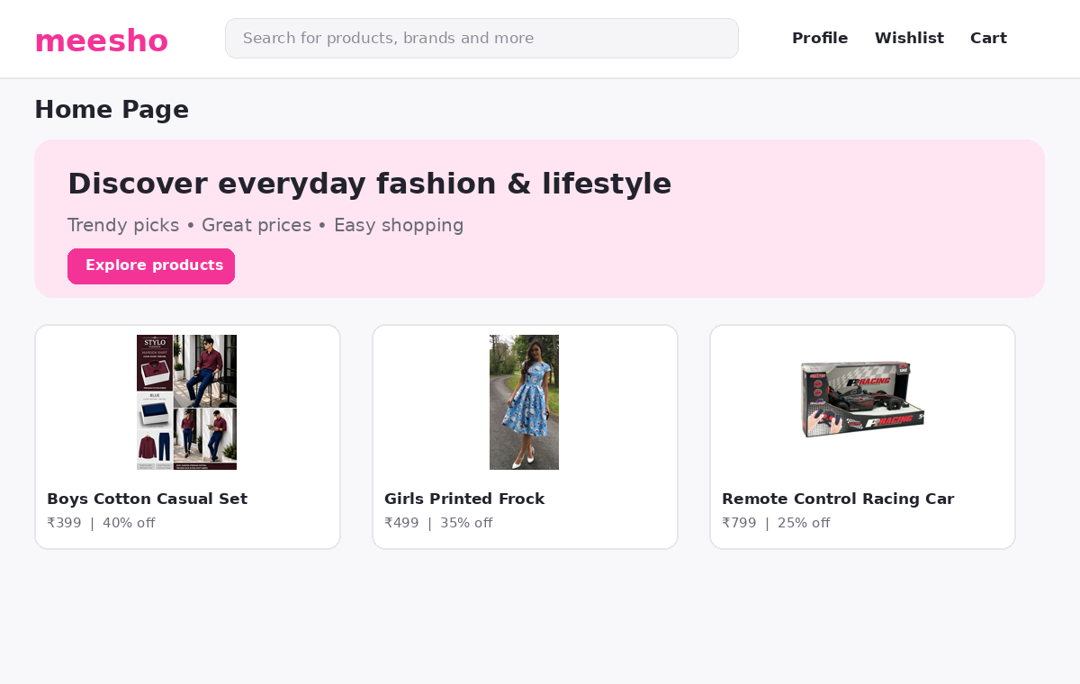
MEESHO-STYLE
E-COMMERCE MARKETPLACE
Project Presentation • MEESHO V15.0
A front-end educational demo covering product discovery, cart, checkout, payment flow and order management.

Slide 2
Project Overview
MEESHO V15.0 • Project introduction
• A multi-page e-commerce marketplace interface inspired by common Indian online-shopping experiences.
• Combines a product catalogue with shopping, account, seller and support workflows.
• Built as a front-end demonstration & It is for the further project demonstrations.
• Purpose: demonstrate web UI design, client-side interactions and a complete shopping journey.

Slide 3
Problem Statement & Objectives
• Users need a clear way to browse products, compare prices and discover categories.
• Shopping journeys should connect product details, wishlist, cart, checkout and order confirmation.
• Build a responsive interface with understandable navigation and consistent page design.
• Demonstrate common marketplace workflows without a production backend.

Slide 4
Technology Stack
• HTML5 — page structure and semantic content.
• CSS3 — layout, styling, responsive rules, transitions and animation.
• JavaScript — search, filters, cart updates, wishlist and demo checkout logic.
• Bootstrap 5.3 and Bootstrap Icons — layout utilities and interface icons & all can be done by passing CDN(Content Delivery Network) in the website or any webpage
• LocalStorage — persists demo cart, wishlist, theme, authentication and order state in the browser.

Slide 5
Home Page — Output
Illustrative output image based on the project pages and included product assets
• Marketplace landing page
• Search and primary navigation
• Promotional hero and product discovery

Slide 6
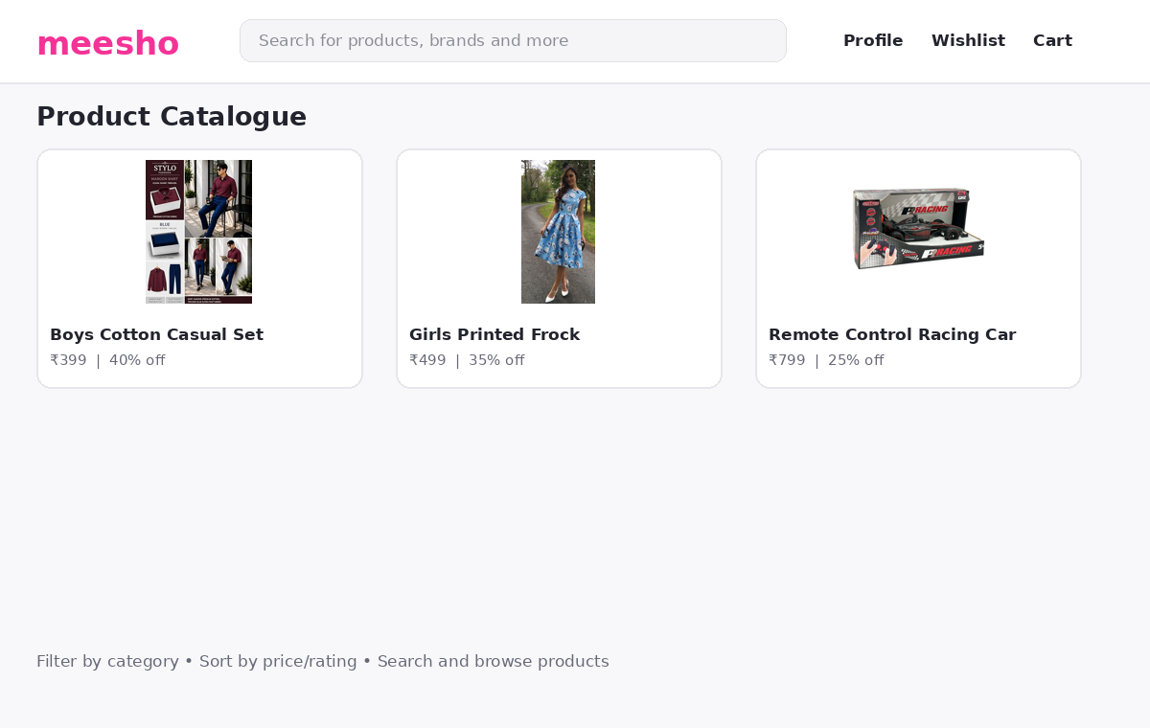
Product Catalogue — Output
• Product cards with names and prices
• Catalogue browsing
• Supports sorting and filters in the project according to the user preferences

Slide 7
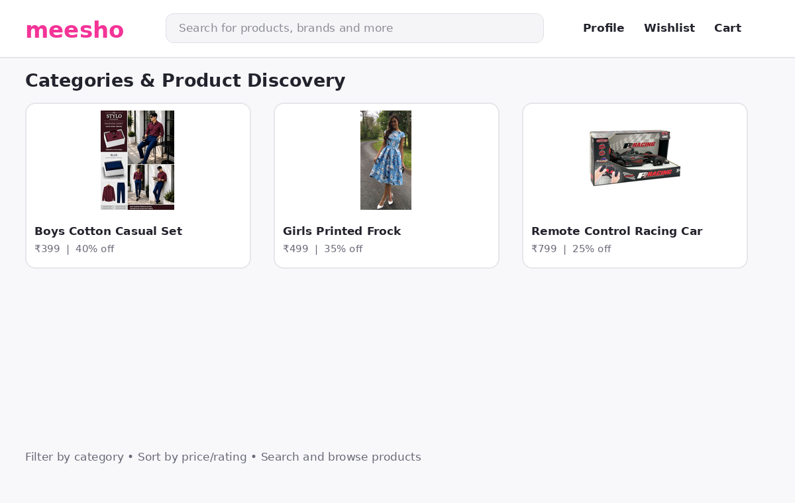
Categories & Search — Output
• Category navigation
• Search results and suggestions
• Price, rating, discount and seller filters

Slide 8
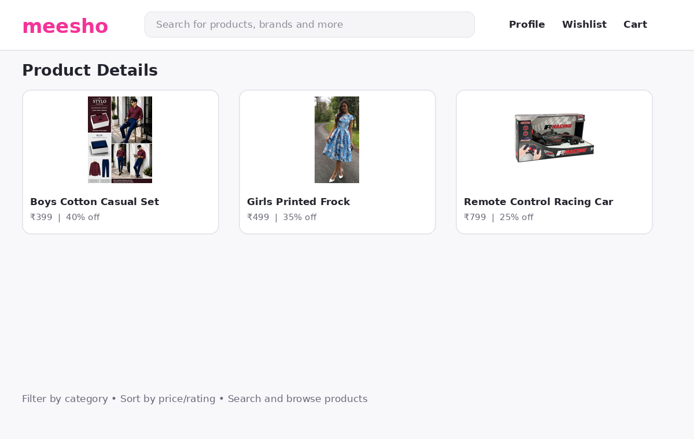
Product Details — Output
• Product information view
• Image switching / quick view flow
• Add-to-cart and wishlist actions

Slide 9
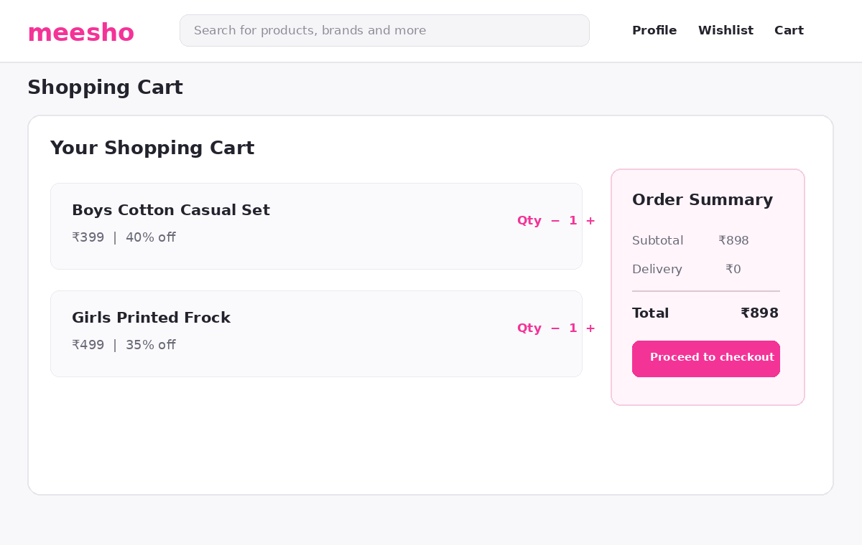
Cart & Wishlist — Output
• Cart quantity controls
• Remove items and calculate totals
• Subtotal, discounts, delivery and grand total and coupon codes also working by passing default coupon codes by the user

Slide 10
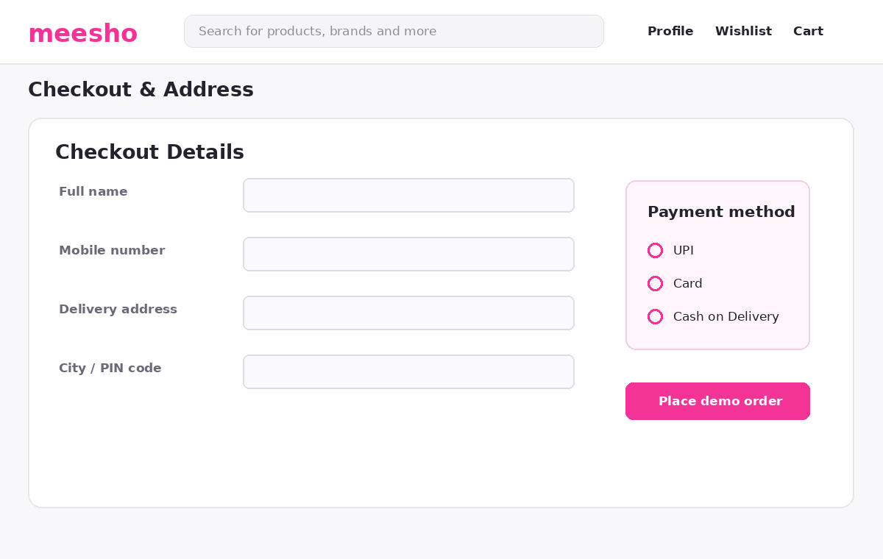
Checkout & Payment — Output
• Address selection and management
• UPI, card and cash-on-delivery & UPI payments can be directly transferred to the product vendor
• Checkout guarded when cart is empty

Slide 11
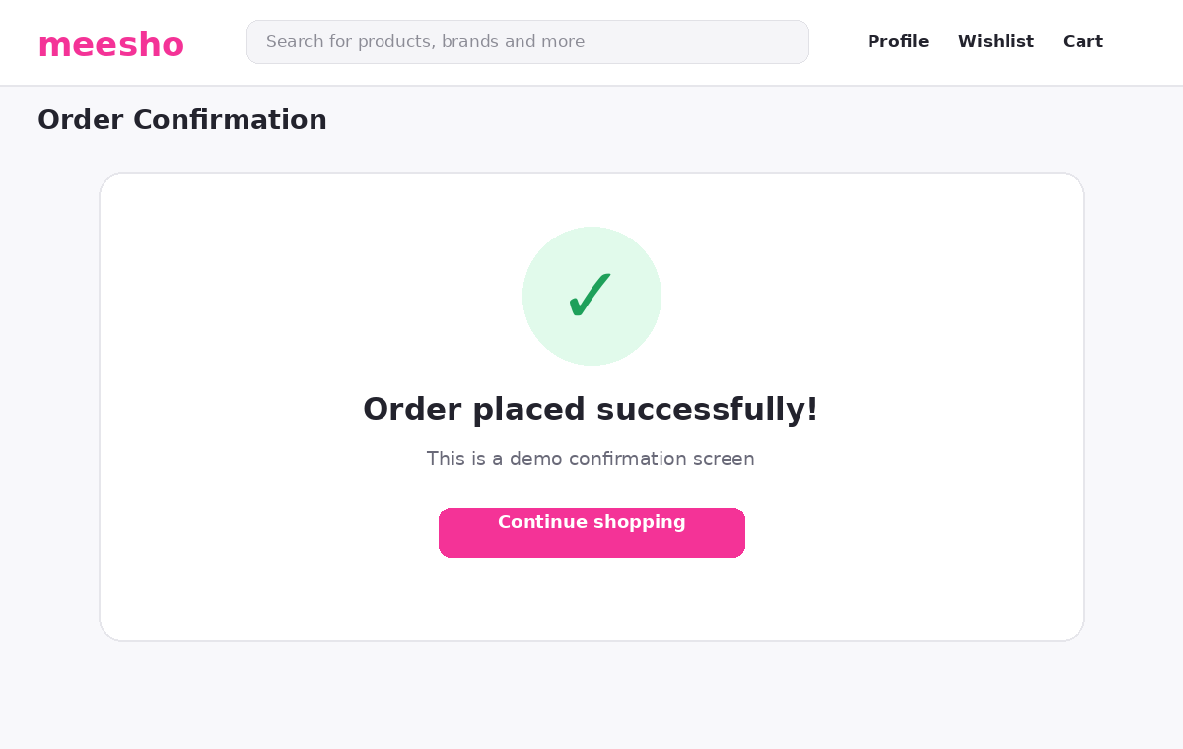
Order Confirmation — Output
• Demo order confirmation
• Orders and tracking pages
• No real order or payment is submitted as this page is only for demo project

Slide 12
Other Modules
• Login, signup and OTP demo flow (demo OTP documented as 123456).
• Profile and saved addresses.
• Notifications, offers, returns and order tracking.
• Seller information / seller onboarding page.
• Help, contact, about, privacy policy, terms and 404 page(When the page is not loaded.

Slide 13
System Flow / Architecture
• User interface: HTML pages and reusable visual components.
• Presentation layer: CSS, responsive styling and animation effects.
• Interaction layer: JavaScript modules for search, cart, wishlist, checkout and orders.
• Browser storage: LocalStorage keeps demo state on the current browser.
• Limitation: no production API, server database, account service or payment gateway.

Slide 14
Testing & Validation
• Navigate through key pages: home, products, details, cart, checkout and order confirmation.
• Check product search, category filtering, sorting and price/rating filters.
• Verify add/remove wishlist, cart quantity changes and totals.
• Check empty-cart guards and demo checkout/payment selection.
• Test page layout at desktop and mobile viewport sizes; verify CDN-dependent assets when online.

Slide 15
Limitations & Future Enhancements
• Current version is a client-side educational demo; payment and orders are not real.
• Connect secure backend APIs and a database for users, products, inventory and orders.
• Integrate a compliant payment gateway and server-side order validation.
• Add admin dashboard, seller inventory tools, authentication security and automated tests.
• Improve accessibility, performance, product image coverage and deployment monitoring.

Slide 16
Conclusion
• The project demonstrates the major screens and interactions of an online marketplace.
• It covers discovery through checkout, along with user, seller and support pages.
• The modular HTML/CSS/JavaScript structure provides a base for future full-stack development.

Slide 17
THANK YOU
Questions & Discussion
MEESHO V15.0 • Educational front-end marketplace demo

